Slide 1

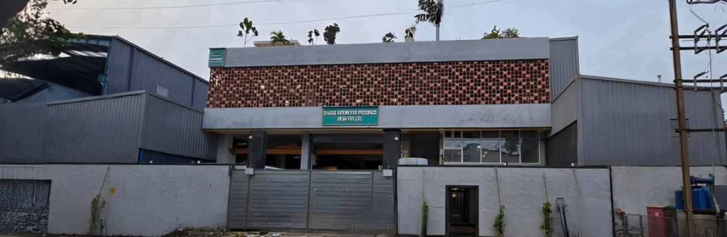
Bharat Automotive Pressings (I) Pvt. Ltd.
1
Business Presentation

Slide 2
About Us
Bharat Automotive Pressings India Private Limited (BAPIPL), an IATF 16949:2016 and ISO 9001:2015 Certified Company, was established in the year 1991. BAPIPL specializes in the manufacturing of Sheet Metal Pressing Components and their sub-fabricated assemblies. To offer a comprehensive range of services, we have incorporated in-house facilities, including pressings ranging from 50 to 500 tons, mechanical and hydraulic presses, Laser cutting and bending, Pipe bending and cutting, Fabrication, and surface treatment. We also excel in tool design and manufacturing.
BAPIPL is strategically located in the heart of the MIDC industrial belt in Pune, one of the largest industrial hubs in India. Situated just 30 kilometres from Pune International Airport.
BAPIPL has established a strong presence across various sectors and industries, including automotive, agriculture, earth moving, railways, material handling, construction equipment, shipping, and defence, among others
A TRUSTED NAME IN SHEET METAL PRESSINGS & FABRICATED ASSEMBLYES

Slide 3
Vision
Our Vision is to Excel in our Journey While developing skills and being Socially responsible
Mission
At Bharat Automotive Pressings (India) Pvt. Ltd, our mission is to become the industry leader in manufacturing high-quality, innovative sheet metal pressed and fabricated components. We are dedicated to:
Customer Satisfaction: Consistently exceeding our customers' expectations through exceptional product quality, timely delivery, and innovative solutions.
Continuous Improvement: Embracing advanced technologies and methodologies to enhance our manufacturing processes and product offerings.
Skill Development: Investing in the continuous development of our employees' skills and knowledge to drive excellence and innovation.
Social Responsibility: Conducting our business with a strong sense of social responsibility, ensuring sustainable and ethical practices in all our operations.
Stakeholder Success: Fostering a collaborative and supportive environment that promotes the growth and success of our employees, customers, suppliers, and community.
Global Competitiveness: Expanding our presence in the international market by delivering world-class products and services that meet the diverse needs of our global customers.
We are committed to shaping a future where our technological advancements and responsible practices contribute to the overall well-being of society and the environment.

Slide 4
Goal Statement
Our primary goal is to become the industry leader in manufacturing and supplying high-quality, innovative sheet metal pressed and fabricated components, focusing on the following key objectives:
Achieve Market Leadership: Secure a dominant position in both domestic and international markets by consistently delivering superior products that meet the evolving needs of our customers.
Enhance Technological Capabilities: Continuously invest in advanced technologies and innovative manufacturing processes to improve product quality, efficiency, and sustainability.
Expand Customer Base: Grow our customer base by building strong relationships, understanding their unique requirements, and providing tailored solutions that exceed their expectations.
Foster Employee Growth: Create a work environment that encourages continuous learning and skill development, empowering our employees to achieve their full potential and contribute to the company's success.
Promote Social Responsibility: Implement sustainable and ethical practices in all our operations, ensuring that we make a positive impact on society and the environment.
Achieve Operational Excellence: Streamline our operations to maximize efficiency, reduce costs, and enhance product quality, enabling us to offer competitive pricing and superior value to our customers.
Drive Innovation: Foster a culture of innovation by encouraging creative thinking, exploring new ideas, and developing cutting-edge solutions that set us apart in the market.
Ensure Customer Satisfaction: Implement robust quality control measures and responsive customer service to ensure that we consistently meet and exceed customer expectations, leading to long-term loyalty and satisfaction.
By focusing on these objectives, we aim to solidify our reputation as a trusted and reliable partner for OEM customers in the earth-moving and automotive sectors and to make significant strides in the international market.

Slide 5
Core Values
Customer Focus
Positive Attitude
People Development
Integrity
Health, Safety & Environment
Team Work

Slide 6
Quality Policy
Bharat Automotive Pressings ( India ) Pvt. Ltd. is dedicated To Provide Quality Sheet Metal Pressings & Fabrications At Competitive Price And Timely Delivery As per Customer Requirement.
We are Committed to achieve The Above Through Systematic Supplier Development And Providing An Environment Which Fosters Team Spirit And Provide Opportunity For learning Creativity & And Innovation.
We are Committed to Continuously Improve The Quality By Creating Awareness And Right Attitude of Employees ,Providing Necessary Infrastructure And System To Meet Every Changing Need Of Customers And Also Committed To Fulfill All Applicable Requirement.

Slide 7
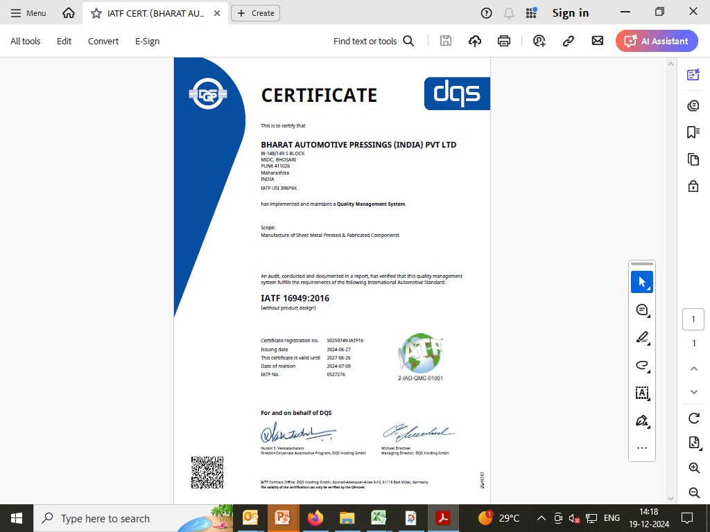
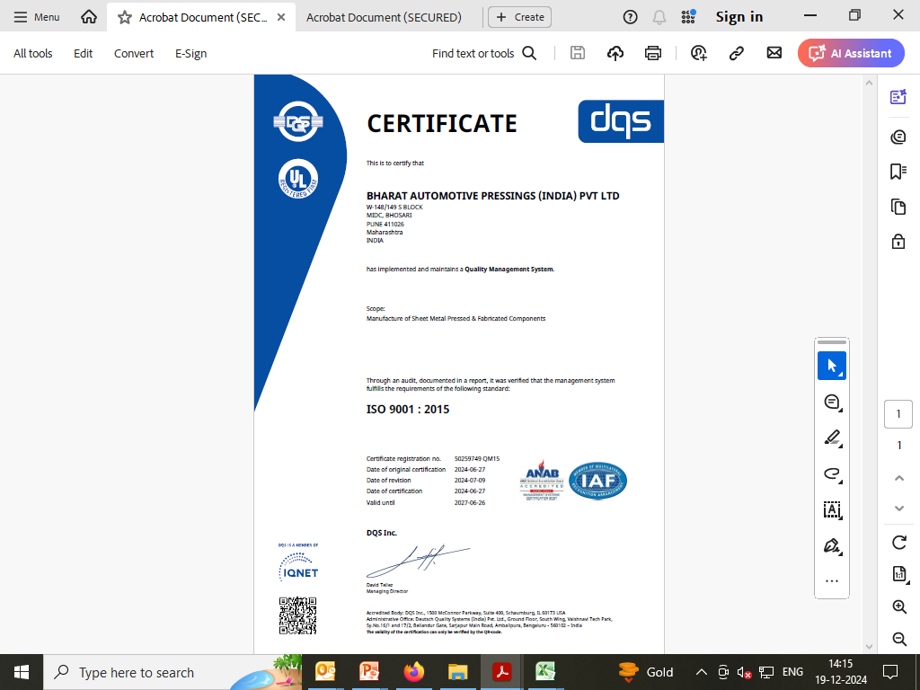
Certificate : ISO 9001 : 2015
Certificate : IATF 16949 : 2016

Slide 8









Our Esteemed Clients:-

Slide 9
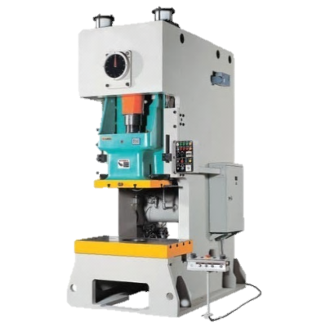
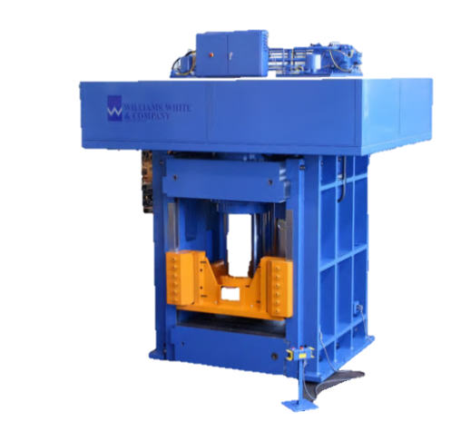
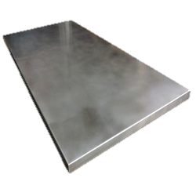
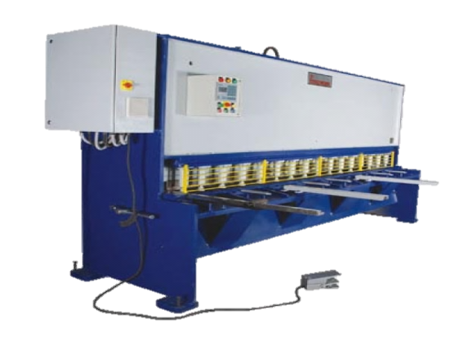
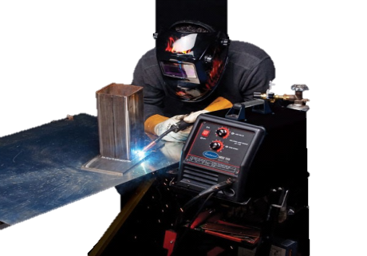
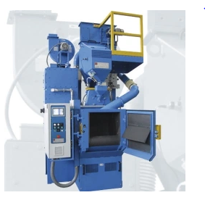
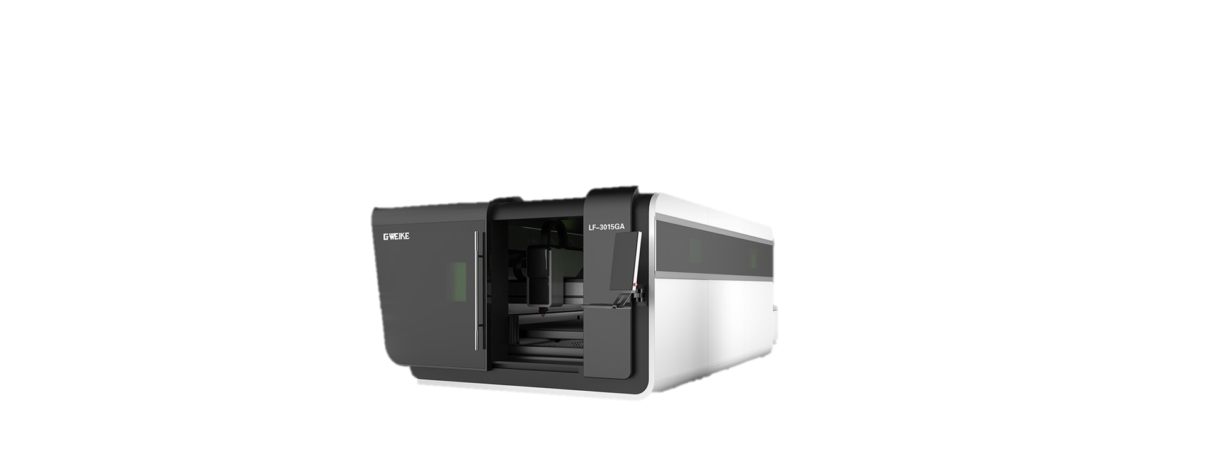
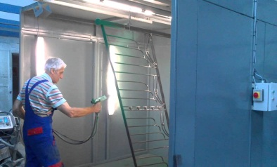
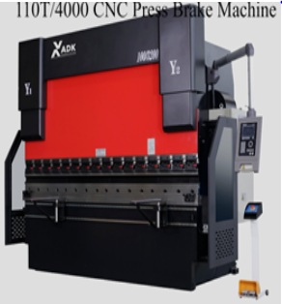
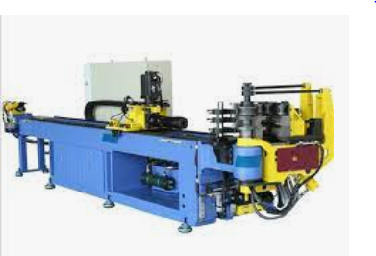
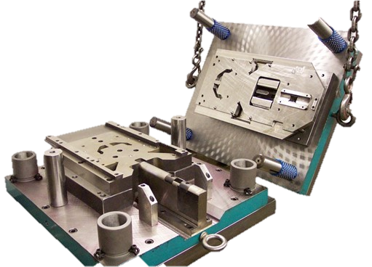
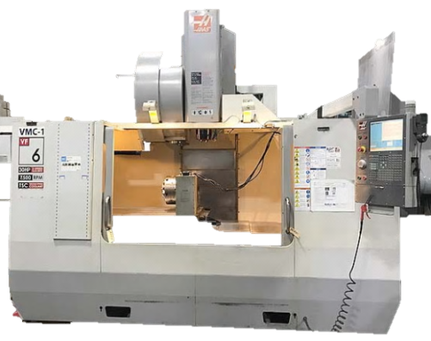
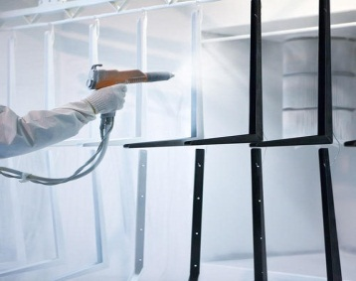
Slide 27
Raw Material Sheet
Shearing Machine
Hydraulic & Pneumatic Press Machines
CO2 Welding Process
Shot Blasting
One Stop Solution For Sheet Metal Pressing & Fabricated Components
Laser Cutting Machine: 10 MM
Powder Coating Process
Laser Cutting Machine : 20 mm
CNC Press Brake Machine
CNC Pipe Bending
Tool Room Setup
Painting Process
9

Slide 10
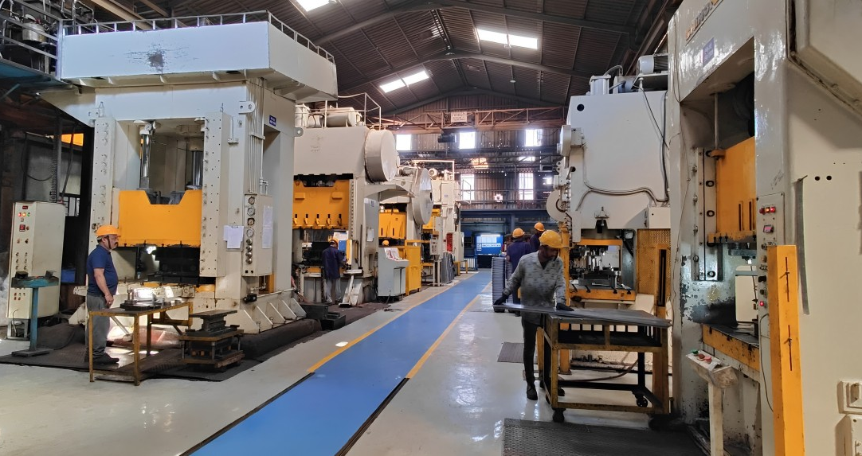
Press Shop Facility:-
Hydraulic Press: 460T for Deep Drawing Max. Length 1000mm x 200mm Draw Depth
Pneumatic Press Machines 160T To 500T
Shearing:- Up to 8MM Mild Steel x 2500mm Length & Cross Shearing facility

Slide 11
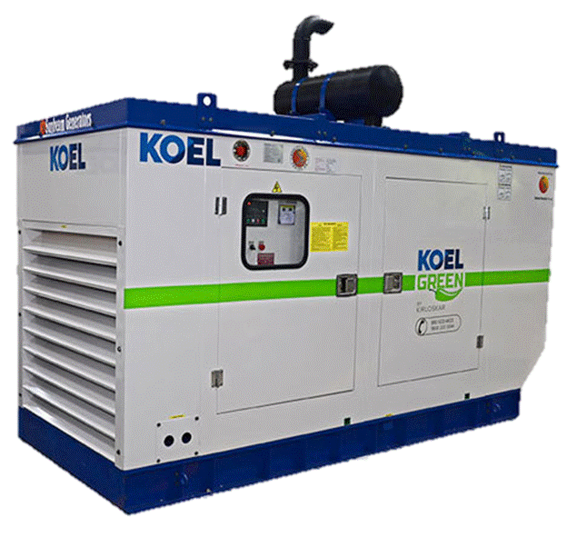
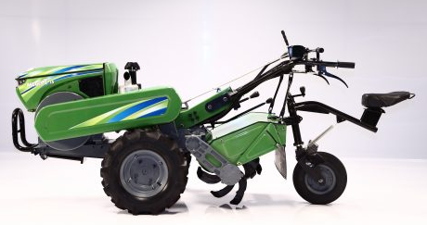
Major Supplier In Sheet Metal Commodity
All Styling Parts are being supplied by Bharat Only
Belt Guard
Bonnet
Silencer & Cover
Steering Mtg.
1.Residential Silencer 2. Genset Mounting Part
3.Oil Sump 4. Heavy Duty Assemblies
5.Piping 6. Pressing & Fabricated Components
7.Bracketory Items
Side Covers
Flywheel Cover
Base Frame
Chain Cover
11

Slide 12
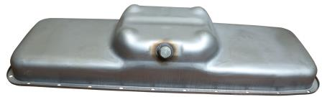
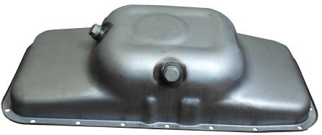
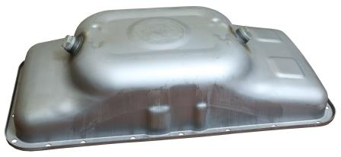
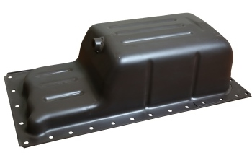
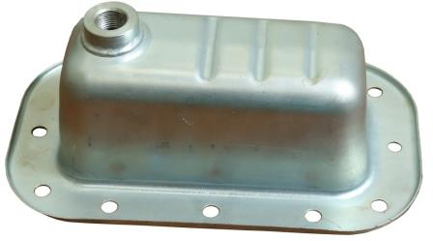
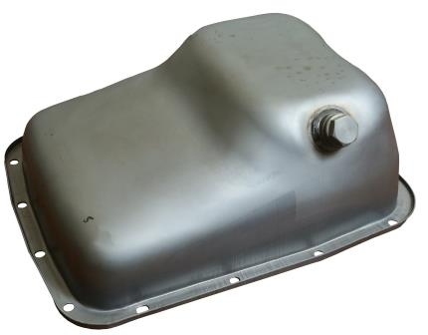
Oil Sump/Pan in Sheet Metal and Fabricated
Specializing in the Manufacturing of Sheet Metal and Fabricated Oil Sumps to Serve OEMs in the Earthmoving and Automobile Sectors Since 2008.

Slide 13
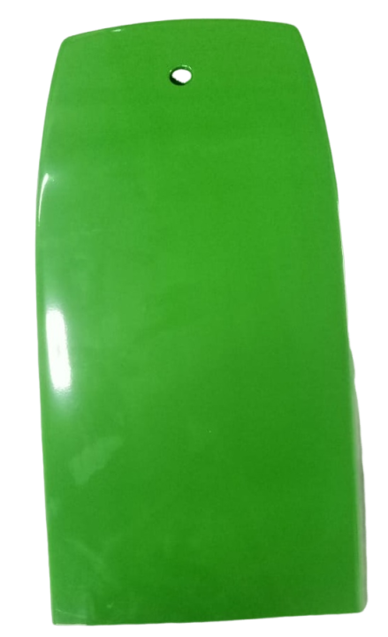
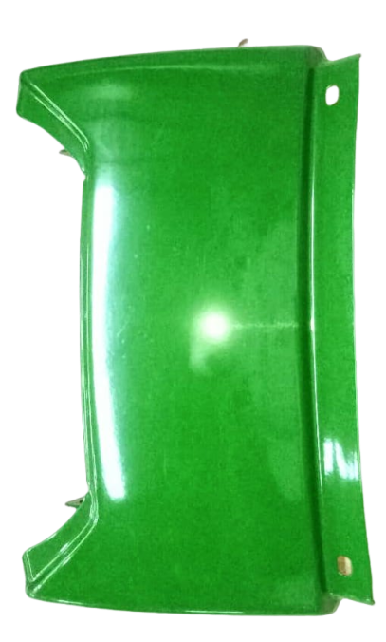
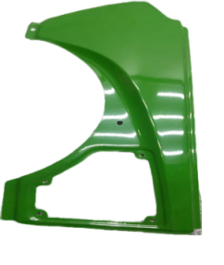
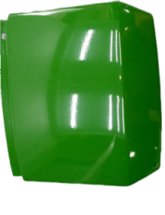
Manufacturing of Sheet Metal Skin Panel
Bonnet
Side Panel
Rear Panel
Front Panel

Slide 14
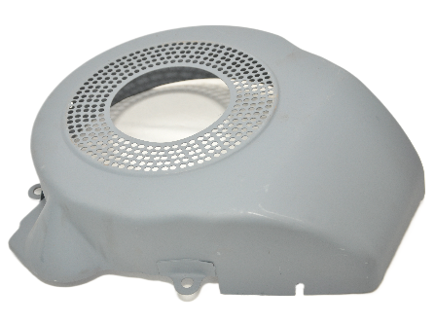
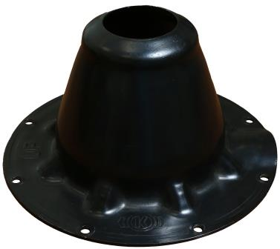
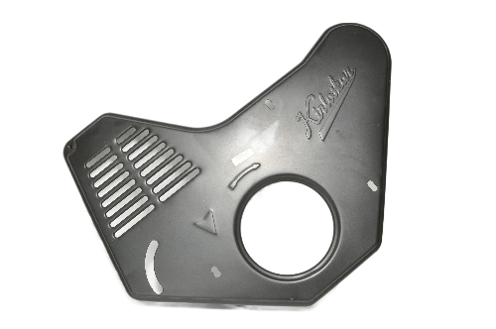
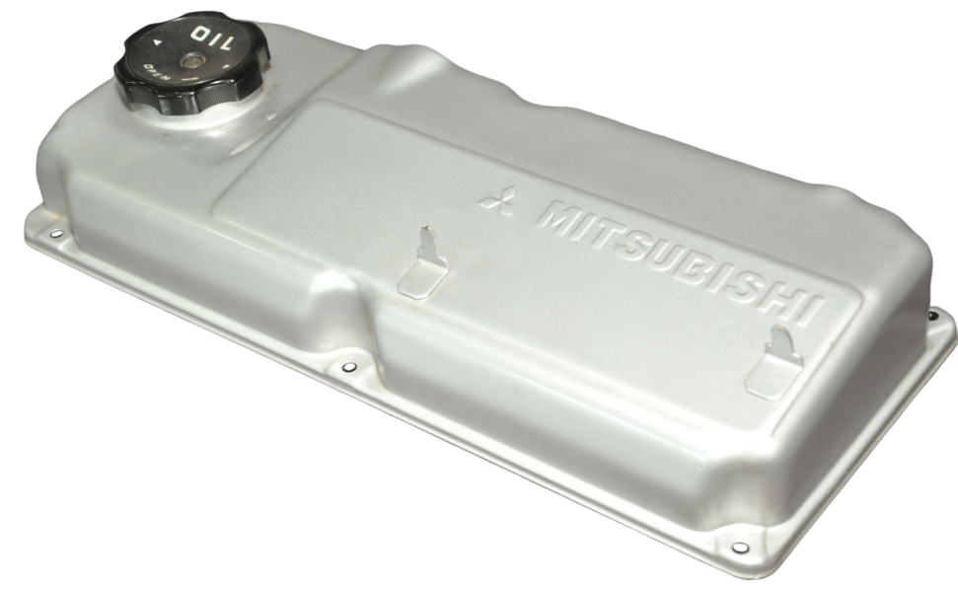
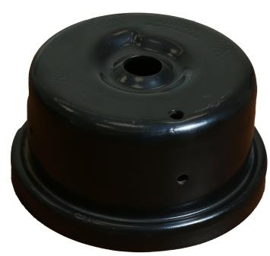
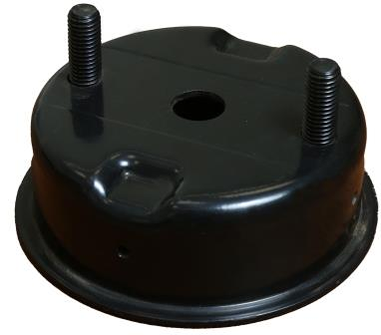

Slide 15
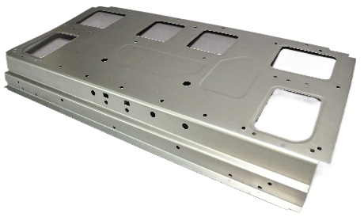
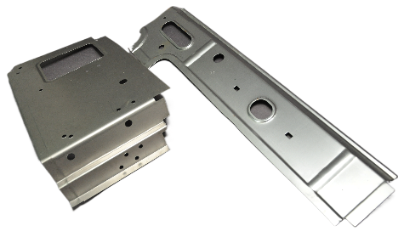
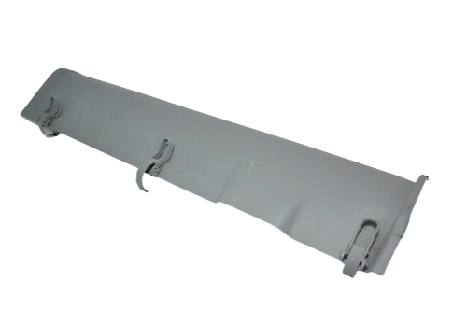
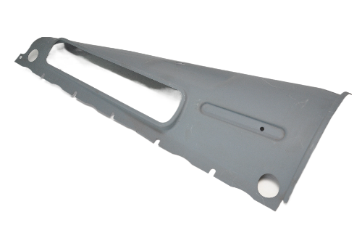
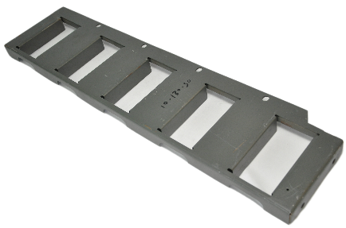
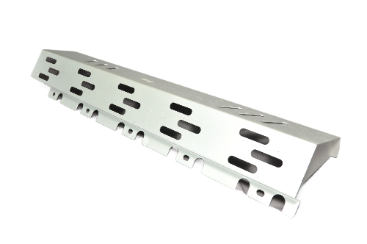

Slide 16
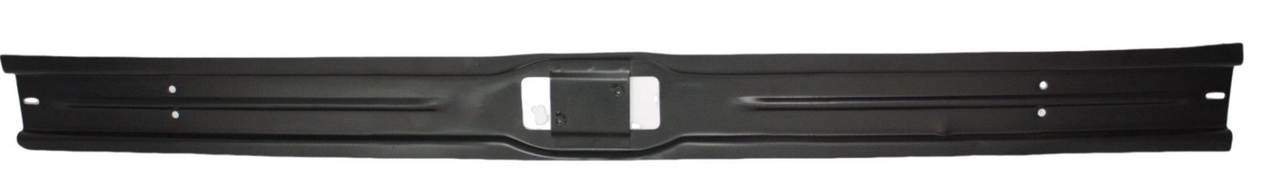
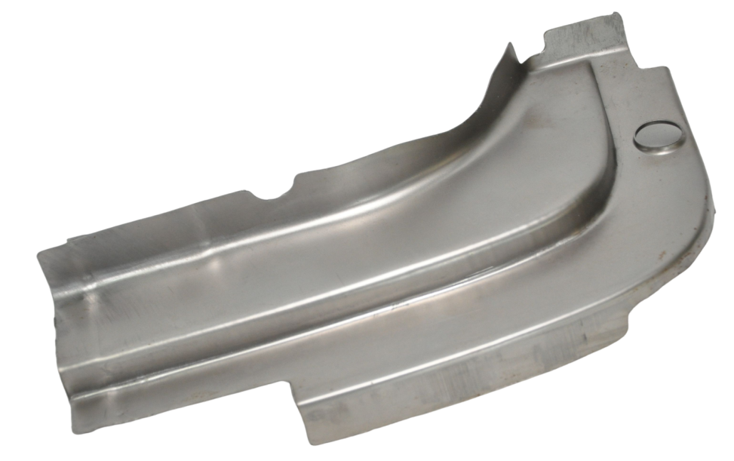
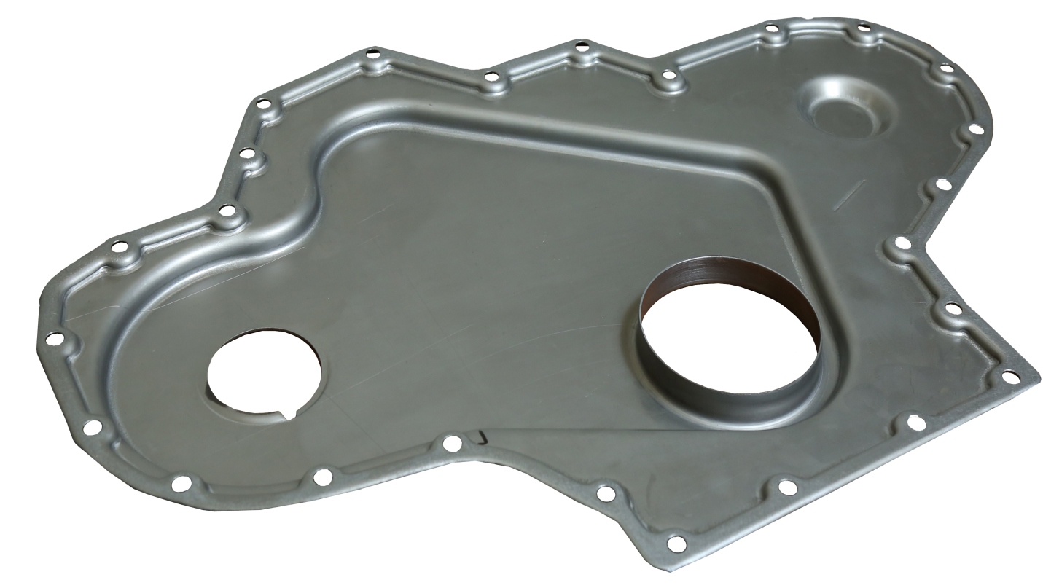

Slide 17
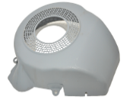
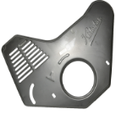
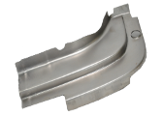
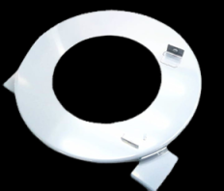
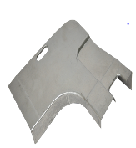
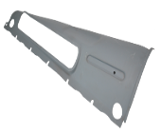

Slide 27
17
Manufacturing Sheet Metal Pressings Component

Slide 18

Fabrication Capacity:-
Spot welding Machine of 17 KVA
Projection Welding Machine of 7 KVA
MIG WELDING M/C Range From 300 Amps To 600 Amps
Linear Welding : Length 1500 mm.
ID Upto 150 mm
Dia 150 -700 mm
Seam Welding Machin: 1500mmLength
Robotic Welding Arm:-1.5Mtr 6 Axis
Laser Cutting Capacity : Thickness 20 mm for MS & 10 mm for SS Material with Cutting Bed of Size 1500X3000mm
Press Brake Bending Capacity : 220 Ton Thickness up to : 10mm x Length – 3200 mm

Slide 19

Manufacturing residential silencers as per customer specifications, with capacities ranging from 10 KVA to 1500 KVA, for OEMs in the earthmoving sectors and gen-sets since 2005.

Slide 20





Slide 21





Slide 22




Fabricated Assemblies

Slide 23






Slide 24




Sheet Metal Fabricated Assemblies

Slide 25

In House Proto Type Development Department

Slide 26

Proto Developed-Base Frame
Railway Gen set base frame manufactured by Proto Route using material with a thickness range of 6.0 to 16mm (IS:2062; E-350). The assembled finish weight is 320 kg,

Slide 27

Protoparts
Part manufactured by using maximum material thickness of 32mm (IS:2062 ;
E-350) and process involved as below:-
Laser Cutting
Fabrication
VMC Machining & Drilling

Slide 28








Proto Components

Slide 29

Capacity :
Upto OD 114 X 3000 mm Length
2 Axis Pipe bending.
Pipe Cutting:- Band Saw machine

Slide 30





Exhaust Piping
NC Hydraulic Pipe Bending suitable for 25 OD in 1.0 to 114 OD in 7.0 mm Thickness.
30

Slide 31



Pipe Bending Components
NC Hydraulic Pipe Bending suitable for 25 OD in 1.0 to 114 OD in 7.0 mm Thickness.

Slide 32

VMC Machining :-
X:-800MM
Y:-510MM
Z:-500MM

Slide 33









Machining Component
33

Slide 34


Slide 27
Surface Treatment
7 Tank Phosphating
SHOT BLASTING
MACHINE
PAINTING
POWDER COATING
Capacity
Depth: 1400mm
Length : 1000 mm
Width :
Capacity
Shot Blasting OD 310
Length : 1200 mm
Heat Resistance Paints (Black Silver)
Air Dry Paints
Epoxy Polymer
Pure Polymer
Color – Black, Red, Grey
34

Slide 35

Commercial Tool Room Facility with 5 Ton Overhead Crane

Slide 36





Slide 27
Tool Room Facility
Sr. No. | Machine Description | Make / Model | Capacity / Size
1 | COMPRESSOR (R/P) | MILLINIAUM | 5 HP
2 | V.M.C M/C | HASS | 1050X600X600
3 | SURFACE GRINDER | ARAVINDA | 27-15/16” x 13-3/8”
4 | MILLING MACHINE | HMT | FN2EV
5 | PILLER DRILLING | PRAKASH N2 | 27Ø MM
6 | LATHE MACHINE | ROLEX | 6’ FEET
Sr. No. | Machine Description | Make / Model | Capacity / Size
7 | RADIAL DRILLING | VIJAY | Φ 38
8 | BENCH GRINDER | ESSVEE Machines Pvt. Ltd. | Φ 200 mm
9 | MILLING MACHINE | AMAN | -
10 | LATHE MACHINE | VIKRANT | 6’ FEET
11 | MILLING M/M1TIR | MANFORD | -
36

Slide 37








Design & Manufacturing of Tools and Fixture
37

Slide 38




Excellent Quality Performance For the year 2014 By Kirloskar Oil Engines Ltd
Appreciation
Award Received For Best Response To New Product Development on 15th Apr-19 By Kirlsokar Oil Engines Limited (KOEL)

Slide 39







Awards

Slide 40

Slide 27
Mr. Sagar Chawla
(Managing Director)
Mr. D. S. Mahajan
(C.E.O)
Contact Detail
schawla@bapipl.com
9049418484
Contact Detail
dsmahajan@bapipl.com
9767896004
Registered Office :
W-148/149, ‘S’ Block, M.I.D.C, Bhosari, Pune-411026
www.bharatautomotive.com
40

